Slide 1

Beginning SQL
19 March 2026
Lynette Barnard

Slide 2
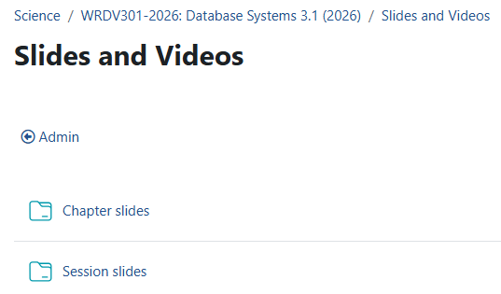
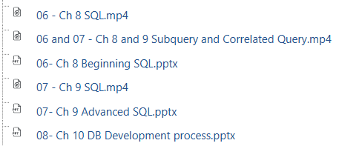
Resources reminder

Slide 3

Intro to SQL
SQL meets ideal database language requirements
Create database and table structures
Perform basic data management (add/delete/modify)
Perform complex queries (transform data into information)
All of the above should be
Minimal user effort
Easy to learn
Portable (conform to some standard)
SQL is non-procedural
Specifies what, not how
Image by Freepik

Slide 4
Intro to SQL
Several broad categories
Data manipulation language (DML)
Insert, update, delete, retrieve, …
DML commands executed within context of transaction (logical unit of work)
Data control language (DCL)
Grant / revoke access to data objects (permissions)
Several SQL “dialects”
Minor differences
Transaction control language (TCL)
Create database objects, indexes, views, define access rights, …
Data definition language (DDL)
Image by Freepik

Slide 5
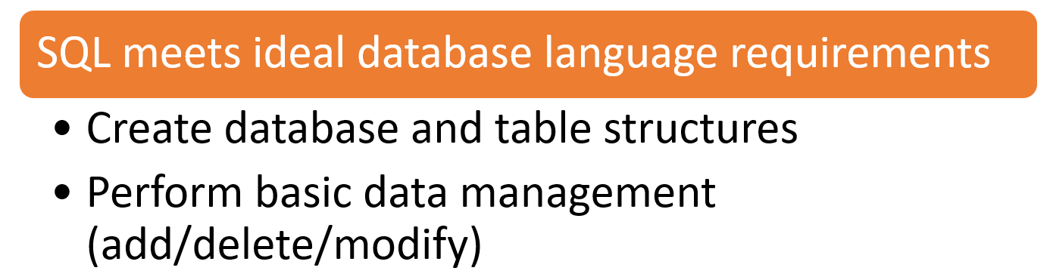
Intro to SQL
Several broad categories
Data manipulation language (DML)
Insert, update, delete, retrieve, …
DML commands executed within context of transaction (logical unit of work)
Data control language (DCL)
Grant / revoke access to data objects (permissions)
Several SQL “dialects”
Minor differences
Transaction control language (TCL)
Create database objects, indexes, views, define access rights, …
Data definition language (DDL)
Image by Freepik

Slide 6
Data definition commands
Creating table structures: syntax
CREATE TABLE VENDOR (
vCode INTEGER NOT NULL UNIQUE,
vContact VARCHAR(15) NOT NULL,
vAreacode CHAR(5) NOT NULL,
vPhone CHAR(12) NOT NULL,
countryCode CHAR(2) NOT NULL,
vOrder CHAR(1) NOT NULL,
PRIMARY KEY (vCode)
FOREIGN KEY (countryCode) REFERENCES COUNTRY
ON UPDATE CASCADE);

Slide 7

Tips and Tricks
Column names
No mathematical symbols, e.g. COUNTRY-CODE
COUNTRY_CODE is acceptable
Be wary of reserved words
E.g. some RDBMS’ have INITIAL as a reserved word
Composite PKs
Order of key components important
Index starts with first attribute, then next

Slide 8
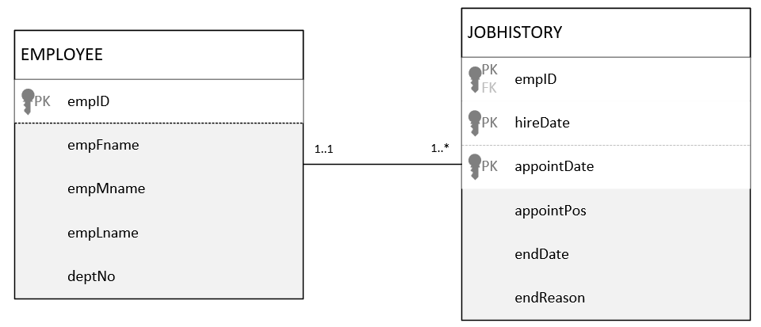
Tips and Tricks
Column names
No mathematical symbols, e.g. COUNTRY-CODE
COUNTRY_CODE is acceptable
Be wary of reserved words
E.g. some RDBMS’ have INITIAL as a reserved word
Composite PKs
Order of key components important
Index starts with first attribute, then next

Slide 9
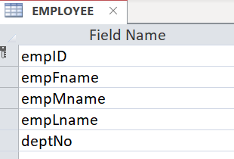
Data manipulation commands
Adding table rows
INSERT used to enter data into table
INSERT INTO tablename VALUES (value₁, value₂, … , value_{n});
If some attributes are optional (no empMname, deptNo)
INSERT INTO employee (empID, empFname, empLname)
VALUES (‘25612’, ‘Joe’, ‘Soap’);

Slide 10
Data manipulation commands
Adding table rows
Can also add rows with Select subquery, e.g.
INSERT INTO tablename
SELECT columnlist FROM tablename;
E.g. add all employees working in deptNo 5 to deptFive table
INSERT INTO deptFive SELECT * FROM employee WHERE deptNo=5;

Slide 11
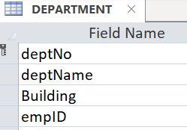
Data manipulation commands
Updating table rows
UPDATE used to modify data in a table
Syntax
UPDATE tablename
SET columnname=expression [,columnname=expression] [WHERE conditionlist];
E.g.
UPDATE DEPARTMENT
SET empID = ‘54812’, Building = ‘Embizweni’ WHERE deptNo = ‘1241’;

Slide 12
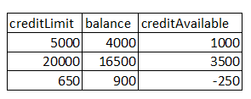
Data manipulation commands
Deleting table rows
Syntax
DELETE FROM tablename
[WHERE conditionlist];
E.g.
DELETE FROM CUSTOMER
WHERE creditAvailable < 0;
WHERE optional (but if NOT added, ALL rows deleted)

Slide 13

Data manipulation commands
(not available in Access: single-user database)
COMMIT
Save table changes
ROLLBACK
Restore table contents
Image by Freepik

Slide 14
Basic SELECT queries
SELECT | Specifies attributes to be returned in resultant table
FROM | Identifies table(s) from which data will be retrieved (include join condition if >1 table)
WHERE | Indicates the criteria used to filter retrieved data
GROUP BY | Groups resultant rows, based on same value in one (or more) attributes (only if you have aggregate in SELECT)
HAVING | Filters groups formed by GROUP BY, based on provided criteria
ORDER BY | Sorts final result based on stated attribute(s) (default Asc)

Slide 15
Basic SELECT queries
SELECT | Specifies attributes to be returned in resultant table
FROM | Identifies table(s) from which data will be retrieved (include join condition if >1 table)
WHERE | Indicates the criteria used to filter retrieved data
GROUP BY | Groups resultant rows, based on same value in one (or more) attributes (only if you have aggregate in SELECT)
HAVING | Filters groups formed by GROUP BY, based on provided criteria
ORDER BY | Sorts final result based on stated attribute(s) (default Asc)

Slide 16
Basic SELECT queries
SELECT | Specifies attributes to be returned in resultant table
FROM | Identifies table(s) from which data will be retrieved (include join condition if >1 table)
WHERE | Indicates the criteria used to filter retrieved data
GROUP BY | Groups resultant rows, based on same value in one (or more) attributes (only if you have aggregate in SELECT)
HAVING | Filters groups formed by GROUP BY, based on provided criteria
ORDER BY | Sorts final result based on stated attribute(s) (default Asc)

Slide 17
Basic SELECT queries
SELECT | Specifies attributes to be returned in resultant table
FROM | Identifies table(s) from which data will be retrieved (include join condition if >1 table)
WHERE | Indicates the criteria used to filter retrieved data
GROUP BY | Groups resultant rows, based on same value in one (or more) attributes (only if you have aggregate in SELECT)
HAVING | Filters groups formed by GROUP BY, based on provided criteria
ORDER BY | Sorts final result based on stated attribute(s) (default Asc)

Slide 18
Basic SELECT queries
SELECT | Specifies attributes to be returned in resultant table
FROM | Identifies table(s) from which data will be retrieved (include join condition if >1 table)
WHERE | Indicates the criteria used to filter retrieved data
GROUP BY | Groups resultant rows, based on same value in one (or more) attributes (only if you have aggregate in SELECT)
HAVING | Filters groups formed by GROUP BY, based on provided criteria
ORDER BY | Sorts final result based on stated attribute(s) (default Asc)

Slide 19
Basic SELECT queries
SELECT | Specifies attributes to be returned in resultant table
FROM | Identifies table(s) from which data will be retrieved (include join condition if >1 table)
WHERE | Indicates the criteria used to filter retrieved data
GROUP BY | Groups resultant rows, based on same value in one (or more) attributes (only if you have aggregate in SELECT)
HAVING | Filters groups formed by GROUP BY, based on provided criteria
ORDER BY | Sorts final result based on stated attribute(s) (default Asc)

Slide 20
SELECT statement options
Purpose of SELECT
Specifies attributes to be retrieved in columnlist
Use alias to replace attribute name as label (e.g. computed column)
SELECT clientID, creditLimit-balance as creditAvailable
Conditional restrictions to restrict output rows (WHERE clause)
SELECT clientID, creditLimit-balance as creditAvailable
WHERE balance > creditLimit;

Slide 21
FROM clause options
Most SELECT queries require data from >1 table
FROM clause contains tables to be joined & join conditions
WHERE clause filters rows on condition(s)
Join condition
Often equality comparison of PK in 1st table and related FK in 2nd table
Number of join conditions always number of tables to be joined minus 1
Tables don’t always have unique attribute names
Manage duplicate attribute names via table qualifier
employee.empID; department.empID

Slide 22
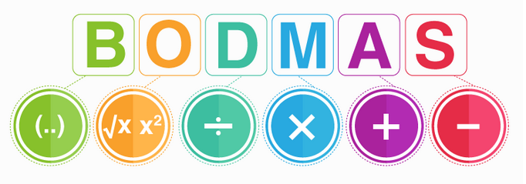
Rule of precedence
SQL often used together with arithmetic operators
Note: * is used for multiplication
Calculate:
30÷6x2-3x2+12÷2=
30÷6x(2-3)x2+12÷2=
10
-4
https://byjus.com/maths/bodmas-rule/

Slide 23
Use of operators
Comparison operators can be used on characters and dates
Logical operators: AND, OR, and NOT
Can be combined (parentheses enforce precedence order)
NOT negates result of conditional expression
<> or != in some dialects

Slide 24
Use of operators
Operator | Description
BETWEEN | attribute value within a range, including lower & upper limit of range
IS NULL | attribute value is null
LIKE | attribute value matches given string pattern wildcards: % and _ ; or * and ?
IN | attribute value matches any value within a value list
EXISTS | checks if subquery returns any rows

Slide 25
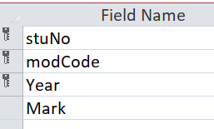
DATE arithmetic
Dates stored in numeric format (day number from point in history)
Example
SELECT stuNo, modCode, year(getdate())-year as creditAge
FROM Takes;
Current date syntax examples
DATE() – MS Access
GETDATE() – SQL Server
CURDATE() – MySQL
SYSDATE – Oracle

Slide 26
Data definition commands
ALTER
ALTER TABLE
ADD (new column; PK; FK)
MODIFY (change column characteristics)
DROP (removes column)
DROP
DROP also used to remove table from database
DROP tablename

Slide 27
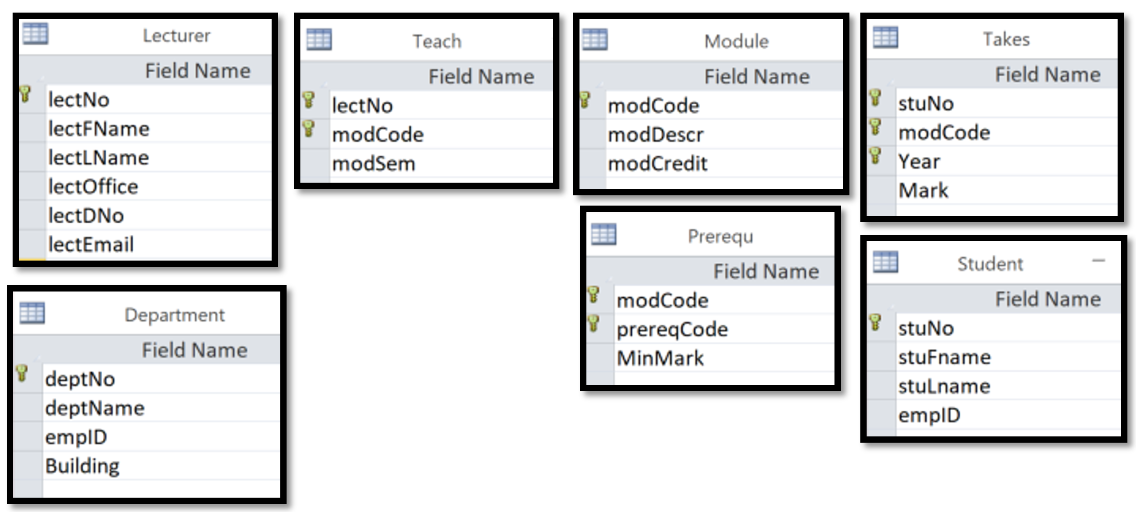
Example

Slide 28
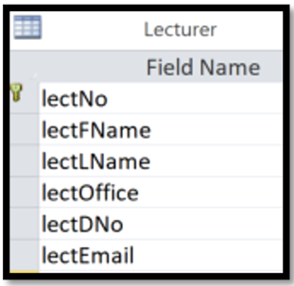
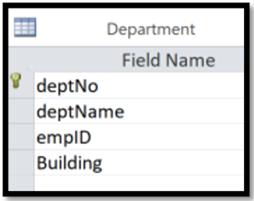
Select queries
ORDER BY clause
SELECT lectFName, lectLName, deptName
FROM Lecturer join Department on lectDNo=deptNo
ORDER BY deptName desc;

Slide 29
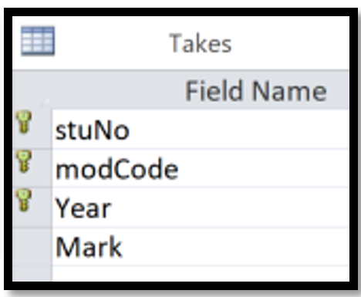
Unique values
DISTINCT
Produces list of unique values (i.e. no duplicates)
SELECT distinct stuNo
FROM Takes;

Slide 30
Aggregate functions
Review video on Funda
All aggregate functions yield a single value
COUNT function tallies number of non-null values of an attribute
COUNT(*) – all rows returned by query
COUNT(column) - number of non-null values in column
MAX/MIN
SUM
AVG

Slide 31
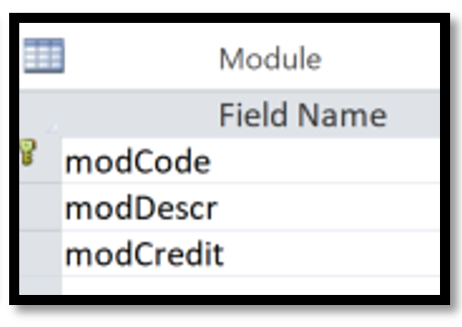
Aggregate functions
Examples
Number of module codes starting with WR
SELECT count(modCode)
FROM Module
WHERE modCode like 'WR%';

Slide 32
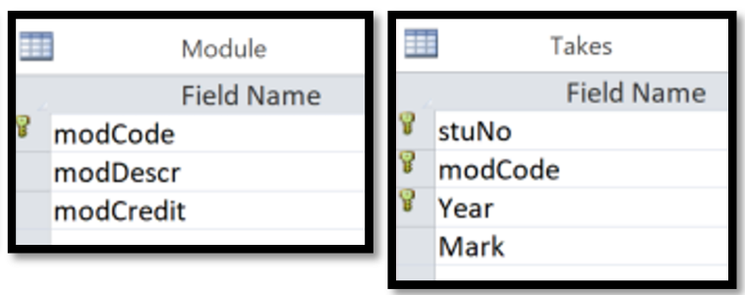
Aggregate functions
Examples
Total credit value of modules passed by student number 123456789
SELECT sum(modCredit)
FROM Module inner join Takes on module.modCode=takes.modCode
WHERE stuNo=‘123456789' and Mark>=50;
How many modules did student number 123456789 pass?

Slide 33
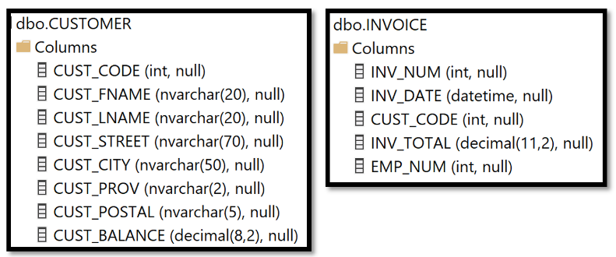
Grouping data
Use GROUP BY clause with SELECT statement
SELECT to contain aggregate function (avg, max, min, count, sum)
GROUP BY list must include all non-aggregate columns specified in SELECT columnlist
SELECT CUSTOMER.cust_code, cust_lname, count(inv_num)
FROM customer join invoice on CUSTOMER.cust_code=INVOICE.cust_code
GROUP BY CUSTOMER.cust_code, cust_lname;

Slide 34
GROUP BY error in SSMS
Msg 8120, Level 16, State 1, Line 1
Column 'customer.CUST_LNAME' is invalid in the select list because it is not contained in either an aggregate function or the GROUP BY clause.
SELECT CUSTOMER.cust_code, cust_lname, count(inv_num)
FROM customer join invoice on CUSTOMER.cust_code=INVOICE.cust_code
GROUP BY CUSTOMER.cust_code;

Slide 35
HAVING clause
Useful extension of GROUP BY
Restrict data based on aggregate value
Restricts groups (not individual rows)
May have both HAVING and ORDER BY clauses
Specify column expression used in SELECT statement columnlist

Slide 36
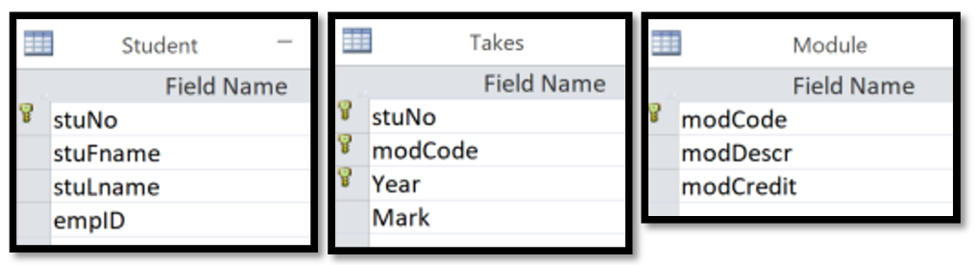
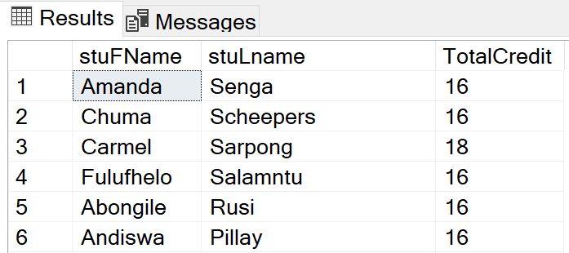
HAVING example
SELECT stuFname, stuLname, sum(modCredit) as TotalCredit
FROM Module JOIN takes ON Module.modCode=takes.modCode JOIN student ON takes.stuNo=student.stuNo
GROUP BY stuFname, stuLname
HAVING sum(modCredit)>=16
ORDER BY stuLname DESC;

Slide 37
HAVING example
SELECT stuFname, stuLname, sum(modCredit) as TotalCredit
FROM Module JOIN takes ON Module.modCode=takes.modCode JOIN student ON takes.stuNo=student.stuNo
GROUP BY stuFname, stuLname
HAVING TotalCredit>=16
ORDER BY stuLname DESC;
Msg 207, Level 16, State 1, Line 4
Invalid column name 'totalcredit'.

Slide 38
HAVING and WHERE clauses
SELECT stuFName, stuLname, takes.modCode, sum(modCredit) as TotalCredit
FROM Module JOIN takes ON Module.modCode=takes.modCode JOIN student ON takes.stuNo=student.stuNo
WHERE Mark>=50
GROUP BY stuFName, stuLname, takes.modCode
HAVING sum(modCredit)>=16
ORDER BY stuLname DESC;

Slide 39
DO NOT use old-style joins
(i.e. join condition in WHERE clause)
SELECT stuFname, stuLname
FROM Module, takes, student
WHERE Module.modCode=takes.modCode and takes.stuNo=student.stuNo and takes.Year < 2001

Slide 40
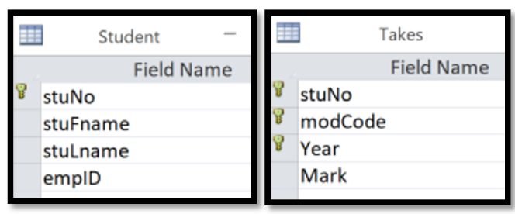
Table joins with an alias
Alias used to identify source table
SELECT s.stuNo, s.stuFname, s.stuLname, t.modCode, t.Mark
FROM student as s join takes as t on s.stuNo = t.stuNo;

Slide 41
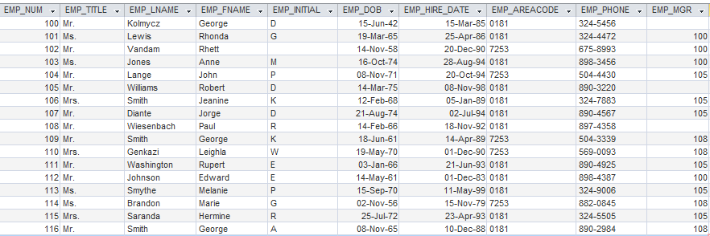
Recursive (self) join
Employee table (emp) lists manager information and employee information

Slide 42
Who manages whom?
Get list of
employee numbers and last names of managers AND
employee numbers and last names of managed employees;
order by manager number.
Table to be joined to itself (i.e. work with 2 copies of same table)
One copy representing “managers”
One copy representing “employees being managed”

Slide 43
Who manages whom?
Get list of
emp numbers and last names of managers AND
emp numbers and last names of managed employees;
order by manager number.

Slide 44
Table to be joined to itself (have 2 copies of same table)
Get list of
emp numbers and last names of managers AND
emp numbers and last names of managed employees;
order by manager number.
SELECT e.emp_mgr, m.emp_lname, e.emp_num, e.emp_lname
FROM emp as e inner join emp as m on e.emp_mgr = m.emp_num
ORDER BY e.emp_mgr;

Slide 45
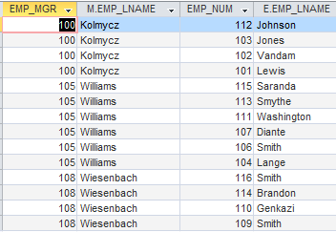
SELECT e.emp_mgr, m.emp_lname, e.emp_num, e.emp_lname
FROM emp as e inner join emp as m on e.emp_mgr = m.emp_num
ORDER BY e.emp_mgr;

Slide 46
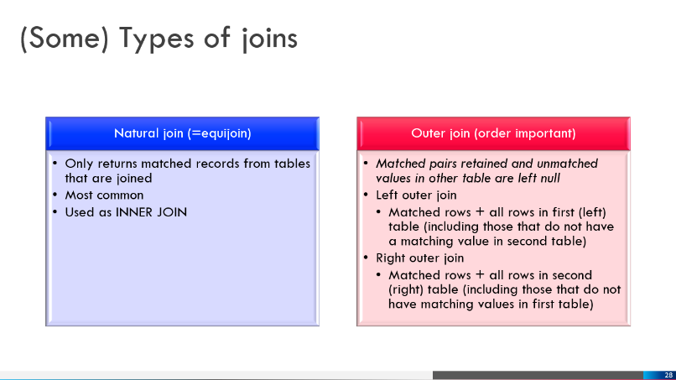
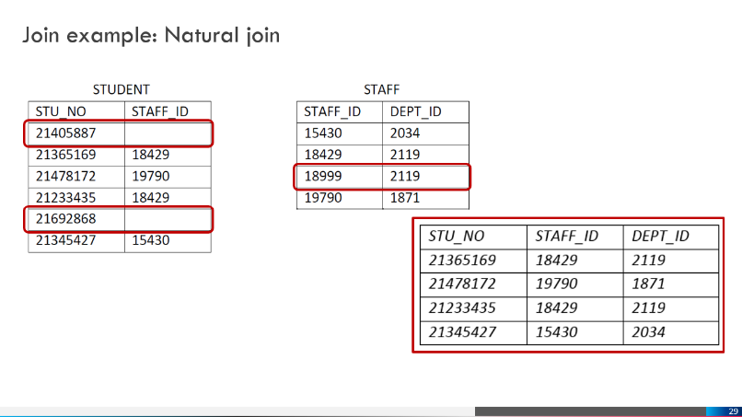
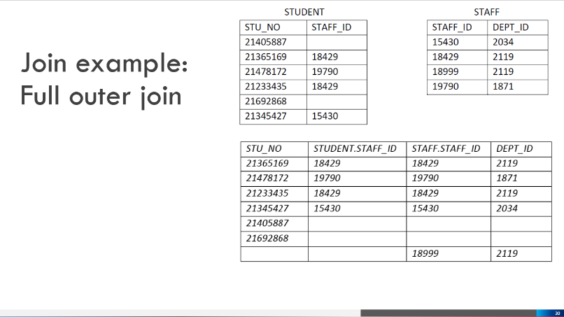
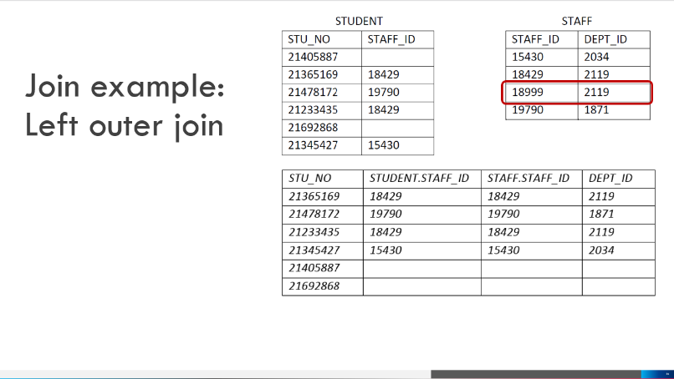
Outer joins – recap slides of 2026-02-19:

Slide 47
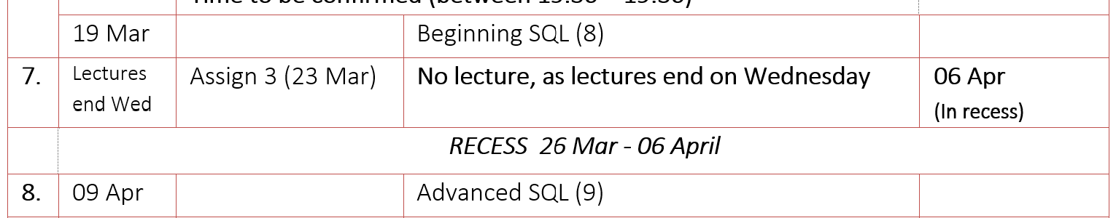
Assignment 3
Assignment 3
Take note of final submission: 6 April (in recess)
Available for consultation (ideally via appointment) up to 26 March @ 12:30

Slide 48

Image by freepik

